Slide 1
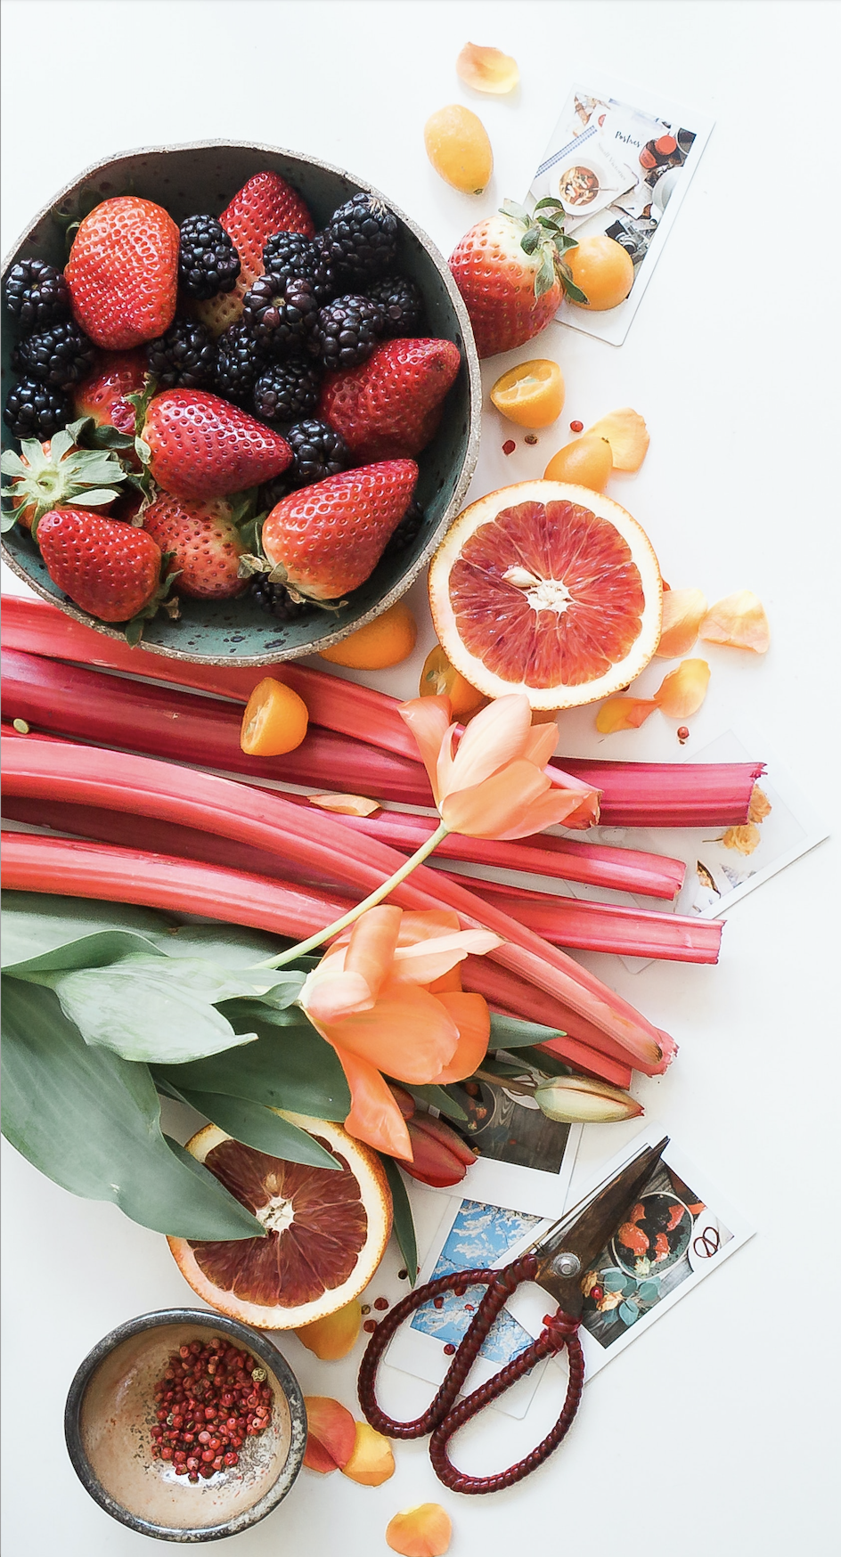
nutriScript
Need a recipe.. Need nutritional facts… think nS
Jon Rahman
Michal Lasa
Eyup Aygun
Marcel Ionite
Ikram Ismail
Noah Sheldon
Notes:
Noah to share screen
Jon

Slide 2
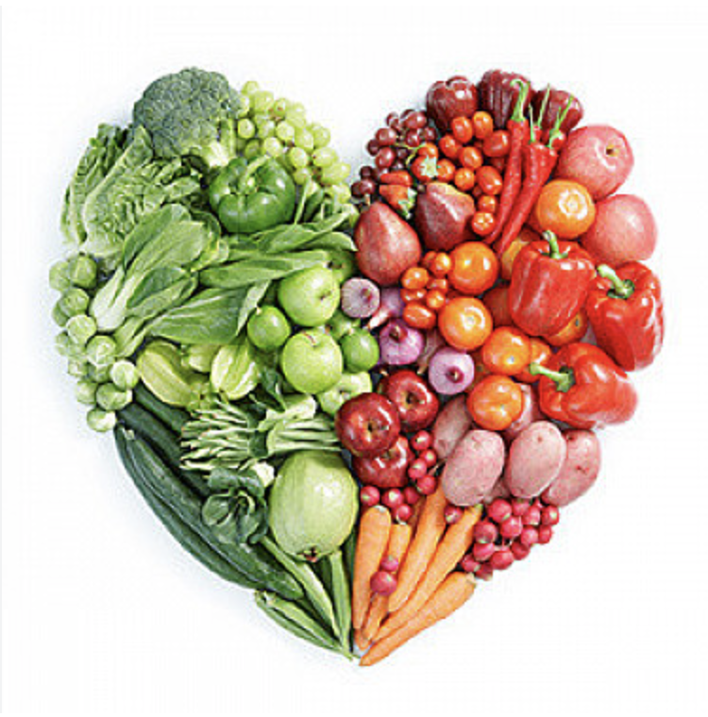
our Idea
Recipe Discovery:
The website is tailored to help users explore recipes for their favorite foods.
Nutritional Insights:
Users gain valuable insights into the nutritional content of their chosen recipes.
User-Friendly Design:
The platform features a user-friendly design to ensure accessibility for everyone.
Inclusivity:
Designed to be utilized by a diverse audience, making it inclusive to all users with dietary requirements and allergies.
Notes:
Jon

Slide 3
tasks /Roles
API for nutrition + JS
Test
We divided the key tasks, delving deeper into each role and utilising GitHub Issues to monitor the status of completed tasks and those currently in progress.
Bootstrap 5.3
HTML, CSS and Bootstrap
+
Wireframe
Merge
Cards for recipe view - Bootstrap
Bug
GitHub
Issues
API for recipe + JS
Filters for recipe
DEV - Ikram, Marcel,
Eyup, Michal
UI/UX - Jon
PM/DEV - Noah
Chartjs
Notes:
Michal

Slide 4

SUCCESSES
Organising issues on GitHub
Identifying strengths in our team
Effective communication between members
LEARNINGS
Time management i.e the expectation of tasks completion
Collaborating on GitHub
Absence of team members due to holiday season.
More knowledge on nutrients required to present it better.
Notes:
Marcel

Slide 5
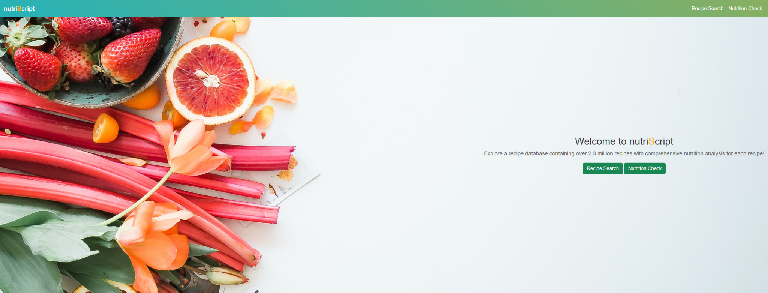
live Demo
Live Link: nutriScript (noah-sheldon.github.io)
Notes:
Recipe - Noah
Nutrition - Eyup

Slide 6

Future Developments
View detailed recipe on nutriScipt.
Meal planning feature
User registration and UX
Better presentation of nutrition.
Notes:
Ikram

Slide 7
links
Deployed Link nutriScript (noah-sheldon.github.io)
GitHub Repo https://github.com/noah-sheldon/nutriScript
Notes:
Ikram

Slide 8
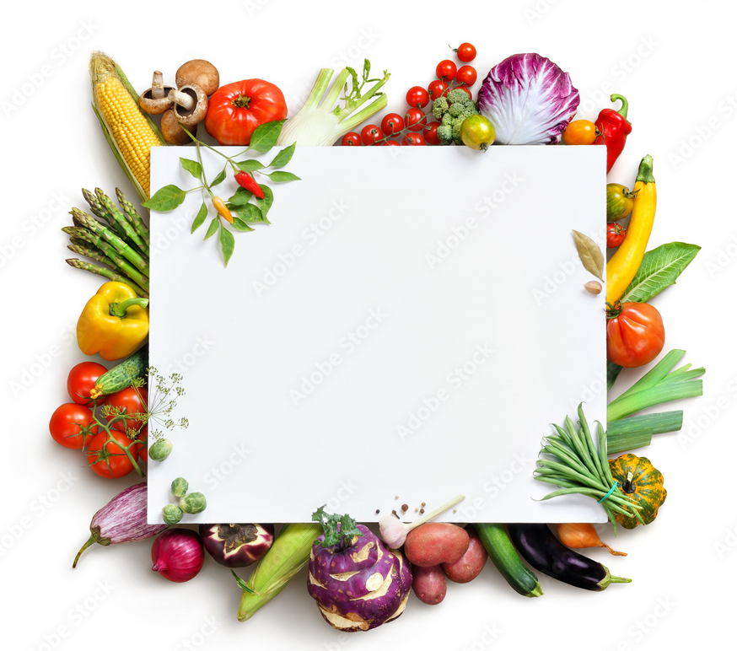
T H A N K Y O U
F O R
L I S T E N I N G!
A N Y
Q U E S T I O N S ?
Notes:
Ikram

